Slide 1

Alexander Ribeiro (extra), 01
Caroline de Paula, 06
Letícia Marissol, 19
Maria Luiza, 28
Creta

Slide 2
I Will Always Love You
By: Whitney Houston

Slide 3
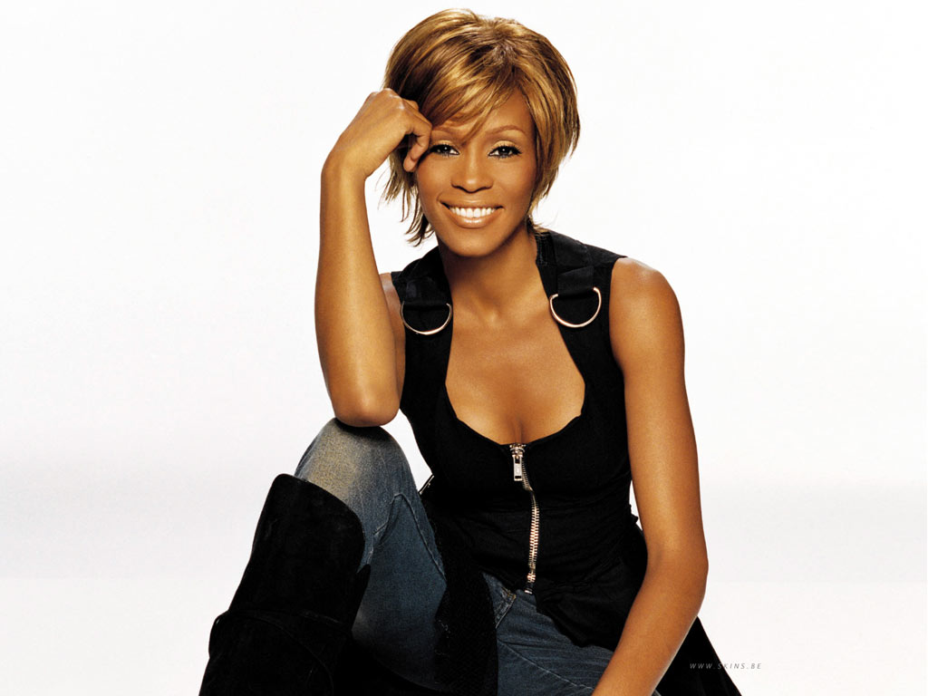
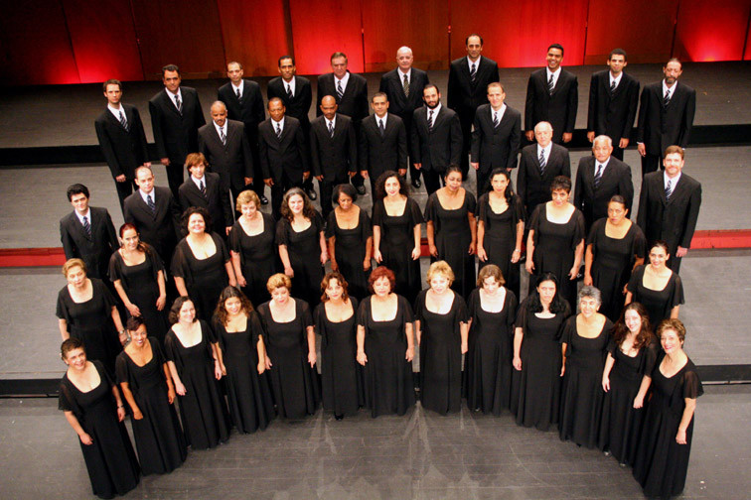
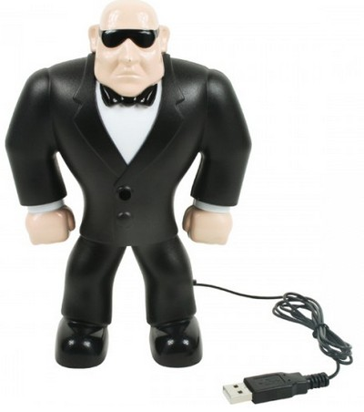
Whitney Houston
  She was one of the most popular in 80’s and 90’s
  She won many awards
  She began singing a gospel choir
The song was recorded by Dolly Parton and covered by Whitney Houston
It was the soundtrack of the movie “The Bodyguard” in 1992

Slide 4

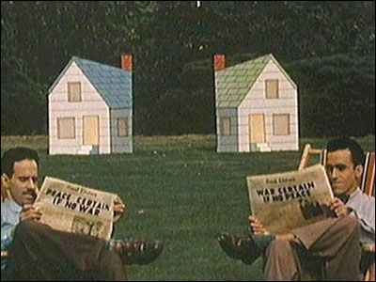
Interesting Fact
An american was sued by his neighbor, because he heard the song for 24 hours.
The psychiatric analysis considered as “psychological torture”

Slide 5
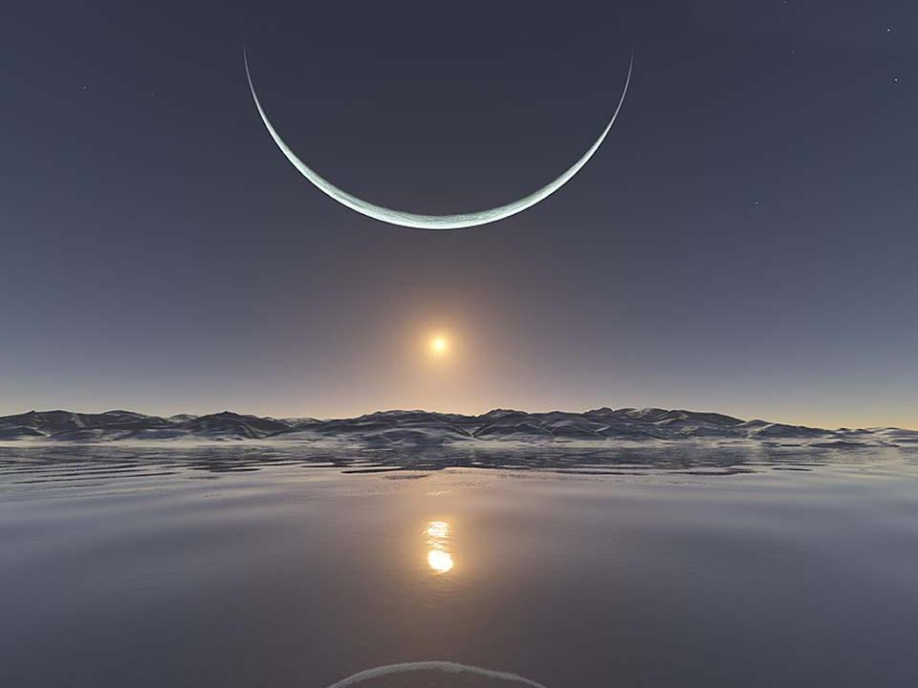
Grammar Topic
Frequency adverbs:
Aux. + Adv + Verb
  I will always love you
I would only be in your way.
www.sofi.com.br

Slide 6
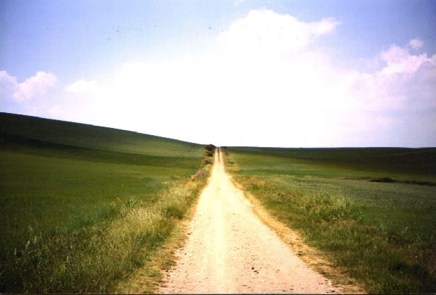

I Will Always Love You
If I should stay
I would only be in your way.
So I'll go but I know
I'll think of you
Every step of the way.

Slide 7
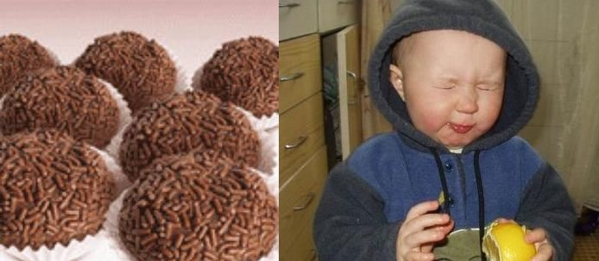

And I... will always love you...
I will always love you...
My darling you
Bittersweet memories,
That is all I'm taking with me...
So goodbye, please don't cry.
We both know I'm not what you, you need

Slide 8


And I... will always love you.
I... will always love you, ohhh
I hope life treats you kind
And I hope you'll have
All you've dreamed of.
And I wished you joy
And happiness.
But above all this, I wish you love.

Slide 9
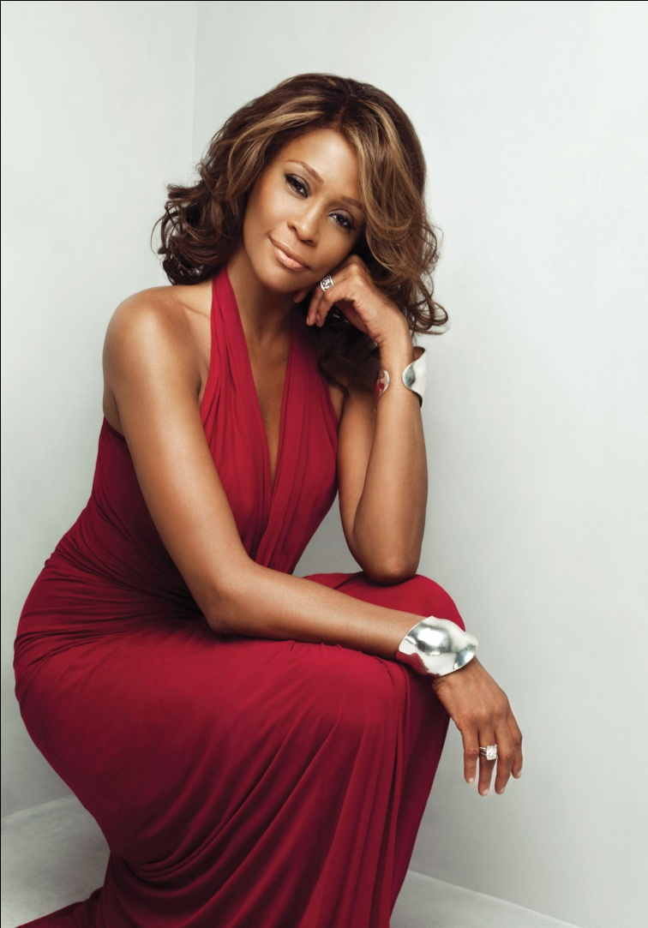
And I... will always love you...
I will always love you... (4 times)
I, I will always love you...you
And I... will always love you...
I will always love you... (4 times)
I, I will always love you...you
Darling I love you
I'll always
I'll always
Love you...

Slide 10

Thank You (:

